Slide 1
Load accesses
Load education series 2025

Slide 2

Load Accesses
All necessary information regarding accesses for HWLoad (in TM1 and DB2) with detailed step by step information are available on Load Publisher page (example for DB2 access on following slides)
HWLOAD For Hwload access you first you need to create an MVS ID for SBRYSL1 on IRT – instructions how to create MVS are here
It also includes instructions how to change MVS password before it expires or
What to do if your MVS ID has been Revoked or blocked, and you need to request a Password / PassPhrase Reset
Step by step instructions how to get DB2 access are also available on HWload Publisher page / DB2 access
DB2 access will allow you to get customer/order level details from DB2 tables (e.g. FNP.WW_ORD_CUR) through QMF Workstation, Power Excel, Power BI or SPSS.
IMPORTANT: If you want to get final quarterly report on WD1 you need to have
1) Blackout DB2 access (access level $WWLSPC2 ) and
2) Active DB2 password (not expired, not revoked)
EPM No special access is required to be able to see HW Load Dashboard.
Instructions how to request access to EPM: Get Access to EPM
Cubes Instruction to get access to three Loadtgts cubes in TM1 (Loadtgts, Streamload, Tks_Tgts) are here
Loadtgts (firm and unfirm HWload),
Streamload (nonHW part, like Transactional and annuity)
Tks_Tgts – tracks targets

Slide 3
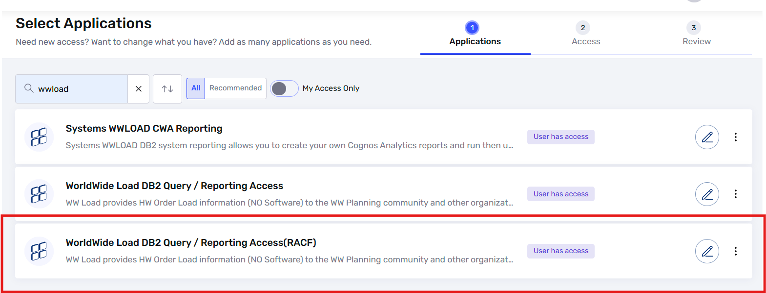
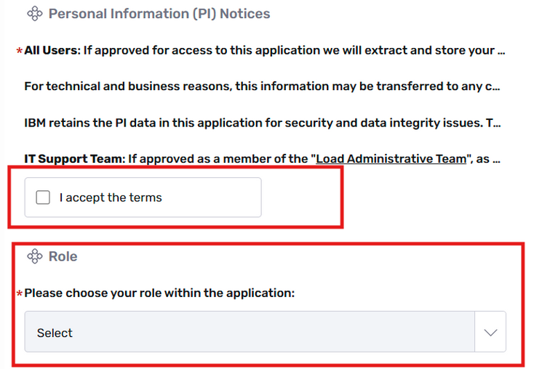
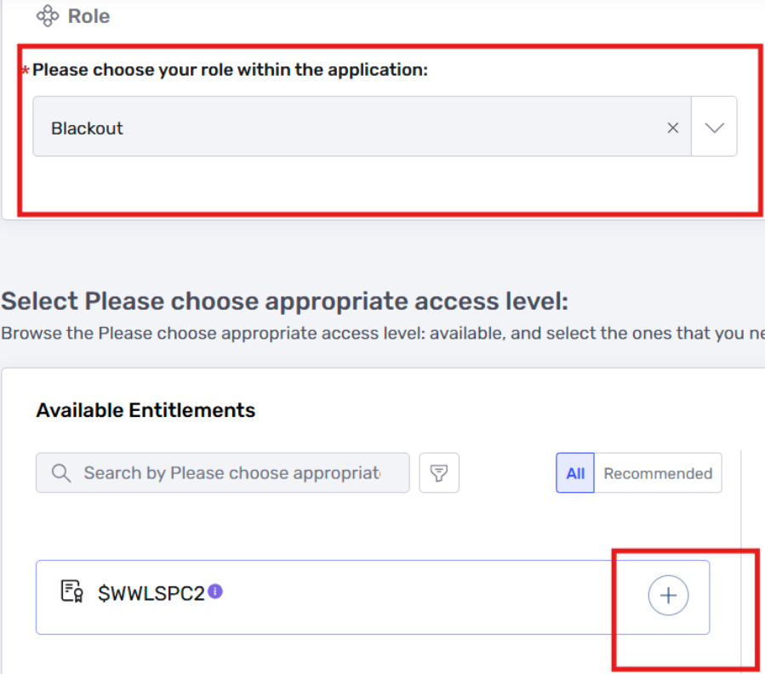
DB2 Access step by step
Go to AccessHub
Choose “Request Access for Self”
In Select Applications enter: "wwload" you will see the following 2 choices:
WorldWide Load DB2 Query / Reporting Access(RACF)
WorldWide Load DB2 Query / Reporting Access
Click on the pencil next to ==> WorldWide Load DB2 Query / Reporting Access(RACF)
If you get an error saying that you need SBRYSL1 access, then send an you must create an id on IRT or
CLAS.
Instructions here.
Once your MVS ID has been created, your manager will receive a temporary password. Change the temporary password immediately or your ID will be revoked, and you'll have to contact the IBM help desk, it will expire every 90 days. Make an entry on your calendar every 90 days to change the pswd as you will not get notified.
MVS Change Password Information
** You must 24 hours before MVS ID appears in AccessHub. If not you will not see the option greyed
out.
With your MVSID id go back to AccessHub and choose WorldWide Load DB2 Query / Reporting Access(RACF).
Click on “Request New Account”
Under Actions, click on “Add to Cart”
Select Account Name window will pop up, select your MVSID.
Click on Checkout then click on Accept terms.
Choose your role within the application: Blackout / No Blackout / Admin
Under "Please choose appropriate access level: $WWLBAS2 for no Blackout or
$WWLSPC2 for Blackout"
Click on the + under Action.
3)
10)
12)

Slide 4
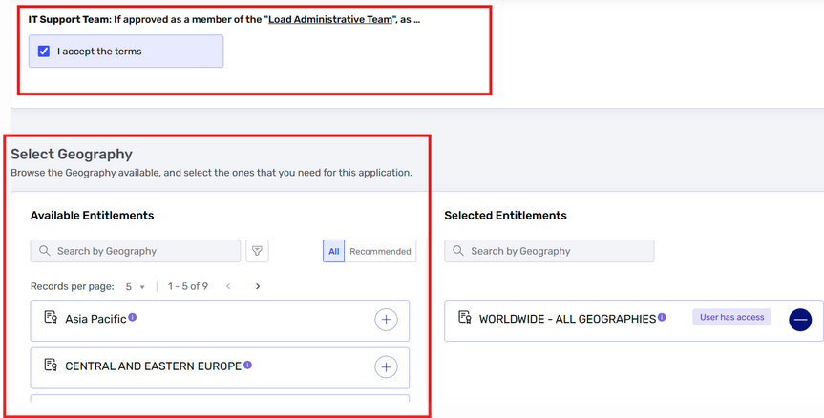
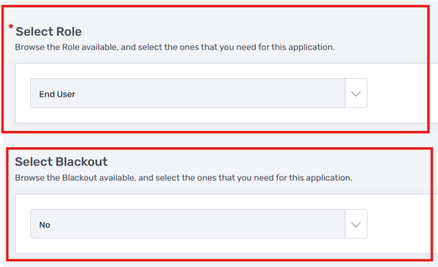
DB2 Access step by step - continue
On the right click "Add Privilege" choose USE
Enter Business Justification and Submit.
Now enter a new AccessHub request to get access to the DB2 Tables for WW Load via AccessHub. Choose “Request New Access”.
Search for wwload and choose WorldWide Load DB2 Query / Reporting Access
Click Request New Account and select the “Dependant Account” MVS ID you created on SBRYSL1. (Takes 24 to 48 hours to show after approvals).
Choose “I accept terms”.
Choose Geography and select +
Select Role: End User
Select Blackout: Yes (must have approval) or No. Click Next.
Enter a Business Reason under Comments.
Click on “I confirm that I have reviewed this request..”
Submit Request.
** Access takes as fast as your manager and the application owner approve it.**
18-19)
20-21)

